Slide 1
MEMS (micro-electromechanical systems)
A MEMS (micro-electromechanical system) is a miniature machine that has both mechanical and electronic components. The physical dimension of a MEMS can range from several millimeters to less than one micrometer

Slide 2
How MEMS are constructed
MEMS are composed of parts such as micro sensors, microprocessors, micro actuators, units for data processing and parts that can interact with exterior pieces
Examples of MEMS
The small system on a chip (SOC) that automatically adjusts screen orientation on a smart phone is an example of a MEMS

Slide 3
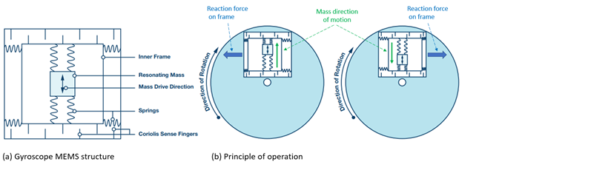

Slide 4
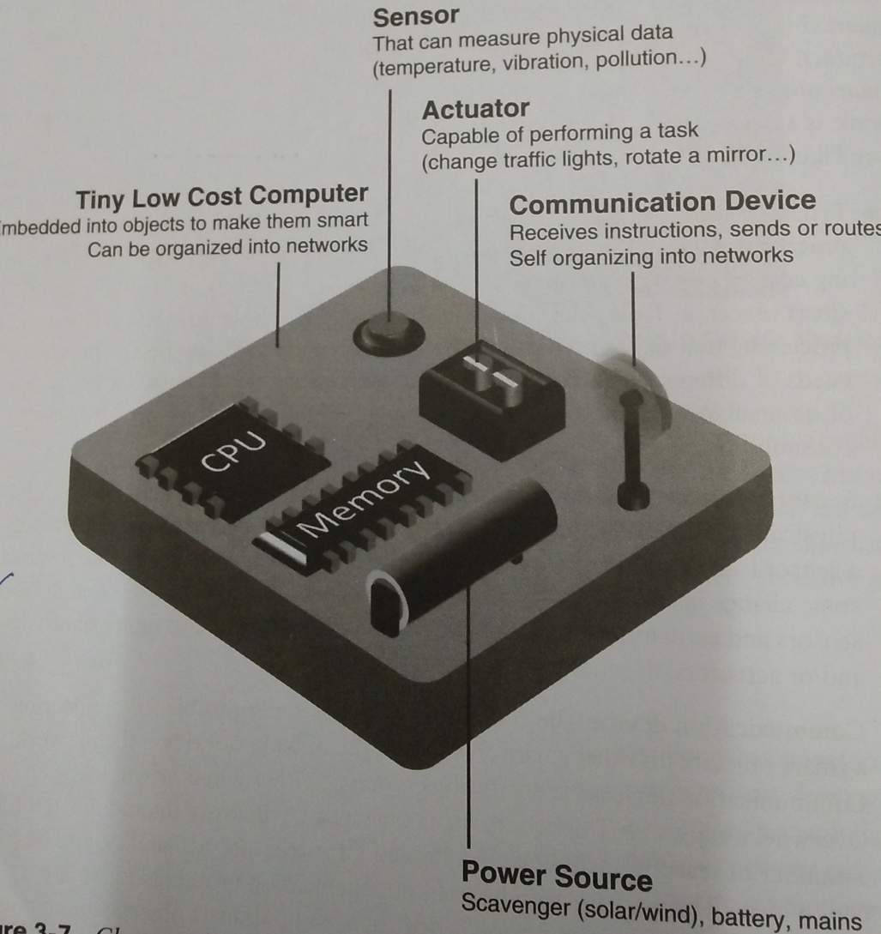
Characteristics of smart object

